Slide 1

ITI Course @ 2025
Ali Ahmed

Slide 2
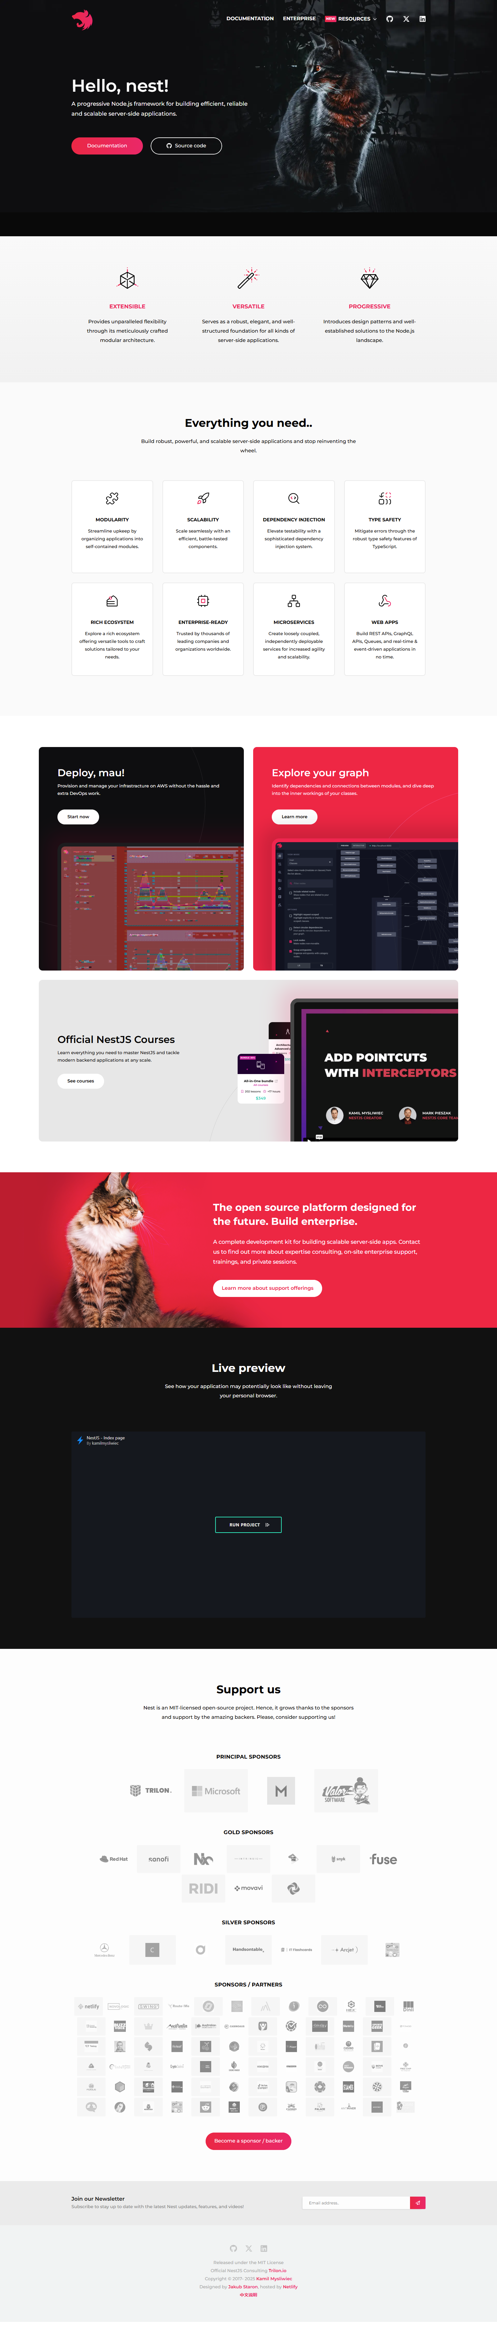

Slide 6
Introduction

Slide 7
Introduction
Supports TypeScript and JavaScript
Built on Top of Express (default) and Fastify
Access to Third-Party Modules (e.g. bcryptjs)

Slide 8
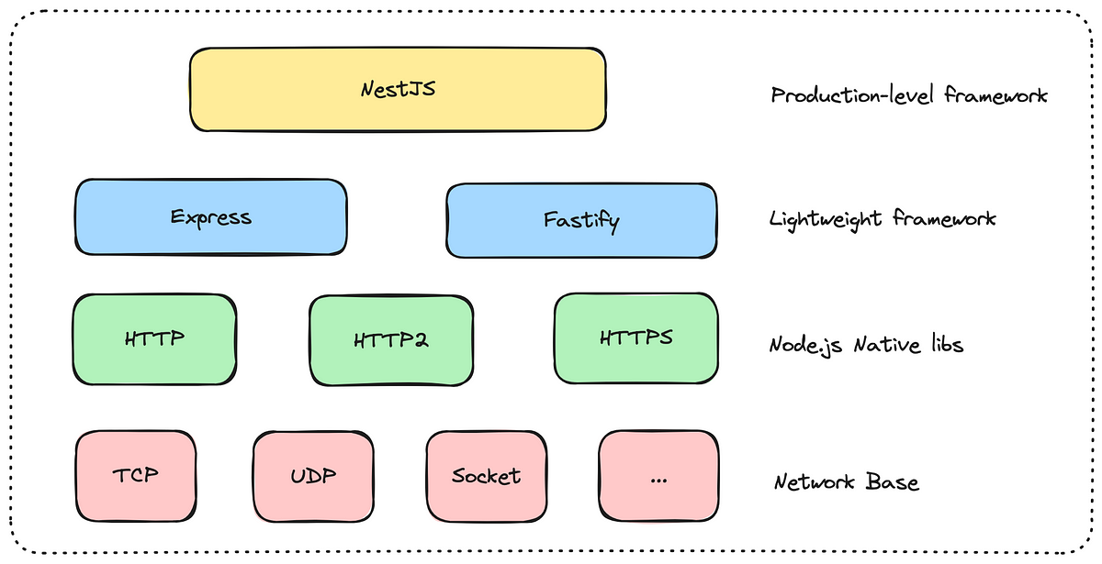
Introduction [Evolution of Node.js Servers]

Slide 9
Installation Steps for NestJS

Slide 10
Installation Steps for NestJS
Start with Nest CLI [Command-line interface tool]
Commands for Nest CLI
Install the Nest CLI globally: npm i -g @nestjs/cli
Verify the Nest CLI is Working: nest --version
Create a New Project: nest new project-name

Slide 11
Basic CRUD Application
Core fundamentals of NestJS

Slide 12
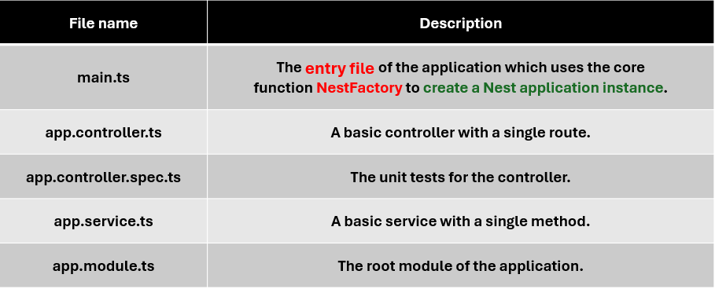
Folder Structure
File name | Description
main.ts | The entry file of the application which uses the core function NestFactory to create a Nest application instance.
app.controller.ts | A basic controller with a single route.
app.controller.spec.ts | The unit tests for the controller.
app.service.ts | A basic service with a single method.
app.module.ts | The root module of the application.

Slide 13
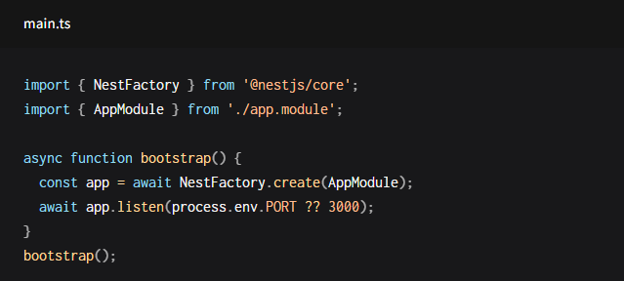
Entry file

Slide 14
Running the application

Slide 15
Running the application
Basic Application Start
npm run start
Compiles your NestJS project.
Starts an HTTP server (usually on port 3000).
Fast Build with SWC Compiler
npm run start -- -b swc
Builds and starts the application using SWC (a super-fast JavaScript/TypeScript compiler).
Offers up to 20x faster builds compared to the default TypeScript compiler.
Development Mode (with Hot Reloading)
npm run start:dev
Watches your source files (src/ directory).
Recompiles the project automatically on file changes.
No need to stop and restart the server after every code change.

Slide 16
Running the application
Command | Purpose
npm run start | Starts the app (default port: 3000)
npm run start -- -b swc | Faster startup using SWC compiler
npm run start:dev | Dev mode with hot-reloading on file changes

Slide 17
Controllers

Slide 18
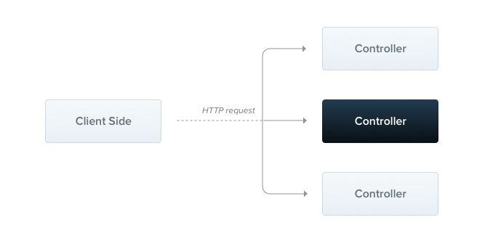
Controllers

Slide 19
Creating a Controller
Use classes and decorators to define controllers.
@Controller('route') sets a route prefix (e.g., 'cats’).
Use the CLI to generate a controller: nest g controller [name-s]
Routing
@Get() creates a GET endpoint handler.
Route path = Controller prefix + method path.
Example: @Controller('cats') + @Get('breed') → GET /cats/breed

Slide 20

What is a decorator?

Slide 21
What is a decorator?
Decorator is a concept that related with Decorator pattern which is a design pattern in object-oriented programming.
Decorators are functions that let you attach new behaviors to objects by placing these objects inside a special wrapper.
TypeScript supports using decorators.
Property Decorators (@Inject())
Method Decorators (@Get())
Parameter Decorators (@Param(), @Body())
Class Decorators (@Controller(), @Injectable())

Slide 22
Response Handling in NestJS
Standard Response (Recommended)
Automatically serializes objects/arrays to JSON. (using return statement)
Returns primitive types (string, number) as-is.
Default status codes:
200 for general requests.
201 for POST requests.
Change status code using @HttpCode(...) or Exceptions
Library-Specific Response (e.g., Express)
Use @Res() decorator in the handler’s signature to inject response object.
Disables standard response handling for that route.
Use @Res({ passthrough: true }) to combine both approaches.
to set headers/cookies but keep Nest in control of the response.

Slide 23
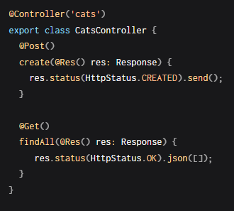
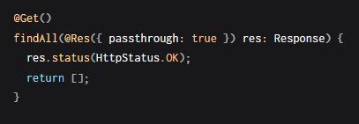
Response Handling in NestJS
Library-Specific Response (e.g., Express)
Use @Res() decorator in the handler’s signature to inject response object.
Disables standard response handling for that route.
Use @Res({ passthrough: true }) to combine both approaches.
to set headers/cookies but keep Nest in control of the response.

Slide 24
Accessing the Request Object in NestJS
Standard NestJS Decorators (Recommended)
Use built-in decorators for platform-agnostic access to request details.
@Param() → Route parameters (req.params)
@Query() → Query strings (req.query)
@Body() → Request body (req.body)
@Headers() → HTTP headers (req.headers)
@Ip() → Client IP address
Library-Specific Request (e.g., Express)
Use @Req() to inject the native request object (e.g., Express.Request).

Slide 25

Accessing the Request Object in NestJS

Slide 26
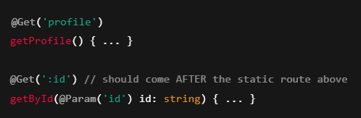
Route parameters
Routes with parameters should be defined after static routes to avoid conflicts.
If you define the dynamic :id route first, a request to /profile could mistakenly match it.
NestJS will interpret "profile" as the :id value

Slide 27
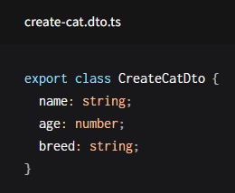
Request Payloads with @Body() in NestJS
What is a DTO?
DTO stands for Data Transfer Object.
It defines the structure of the expected request payload.
Think of it as the shape of the data coming from the client.

Slide 28
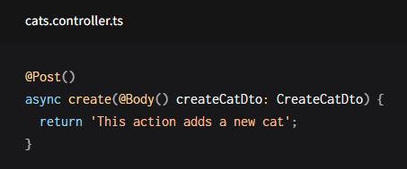
Request Payloads with @Body() in NestJS
What is a DTO?
DTO stands for Data Transfer Object.
It defines the structure of the expected request payload.
Think of it as the shape of the data coming from the client.

Slide 29
Request Payloads with @Body() in NestJS
Why use classes instead of interfaces?
Classes are part of the JavaScript ES6 standard, so they remain intact as real entities in the compiled JavaScript.
In contrast, TypeScript interfaces are removed during transpilation, meaning Nest can't reference them at runtime.
This is important because features like Pipes rely on having access to the metatype of variables at runtime, which is only possible with classes.

Slide 30
Registering the Controller
Controllers must be declared inside a module.
Why This Step is Required
NestJS is built around the concept of modules [blocks that help organize code and manage dependency injection]
so that the Nest runtime can:
Discover and instantiate the controller
Bind it to the HTTP routing system
And inject any required dependencies via the module system

Slide 31
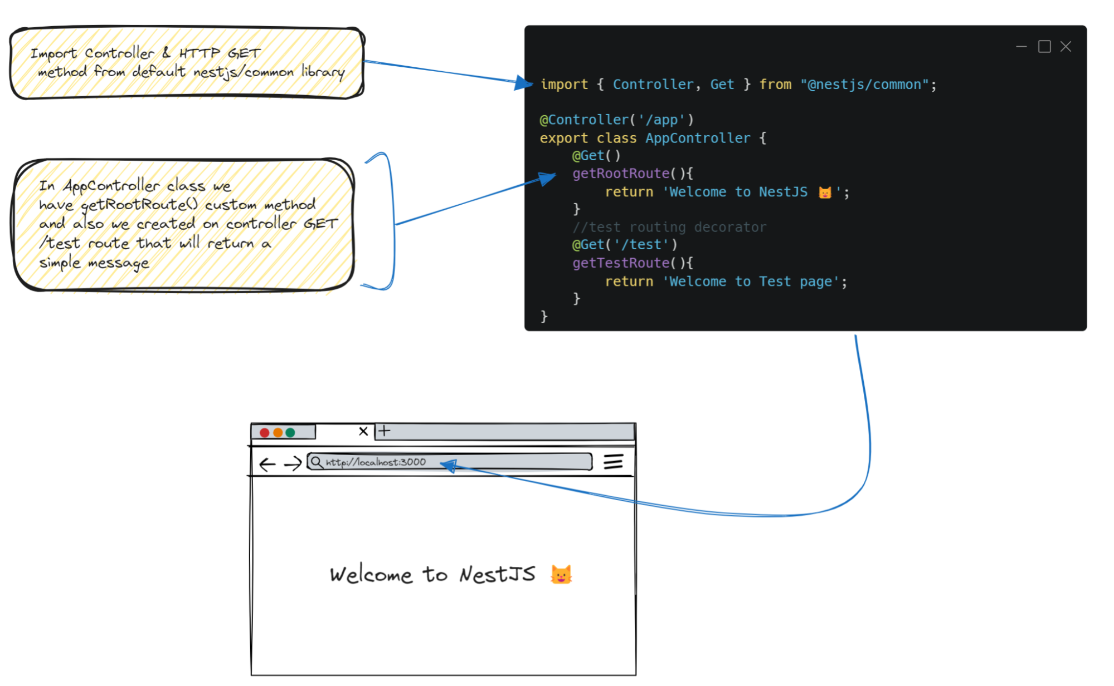

Slide 32
Providers

Slide 33
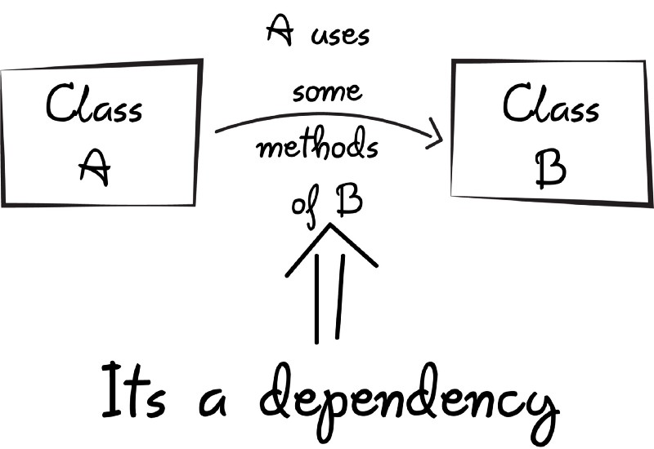
Providers

Slide 34
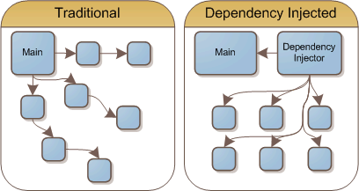
Providers

Slide 35








Providers

Slide 36
Provider Scope (Injection Scopes)
Scope | Lifetime | Use Case
DEFAULT (Singleton) | One instance for the entire app lifecycle | Caching, DB connection, logging, configuration
REQUEST | New instance for each HTTP request | Multi-tenancy, request tracking, per-request cache
TRANSIENT | New instance for each injection (consumer) | Stateless services that hold no shared data

Slide 37
Scope Hierarchy in NestJS
Request Scope Affects All Parents
A controller or provider automatically becomes request-scoped if it depends on another provider that is request-scoped.
Transient Scope Does Not Affect Parents
If a singleton service injects a transient provider, it receives a new instance, but the singleton remains singleton.
To make a dependent also transient, you must explicitly mark it as TRANSIENT.

Slide 38
Provider Scope Best Practices
Use SINGLETON by default for performance.
Use REQUEST scope only when needed.
Use TRANSIENT for lightweight, stateless services like utilities and formatters.
Why Singleton Scope Is Recommended (Default)
Singleton scope is highly performant.
NestJS caches metadata and only creates one instance per provider.
Most services (like LoggerService, DatabaseService) don't need to change per request.

Slide 39
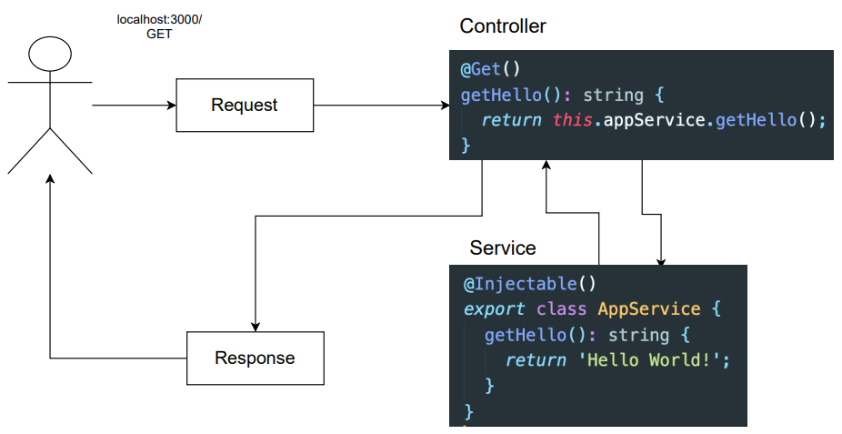

Slide 40
Modules

Slide 41
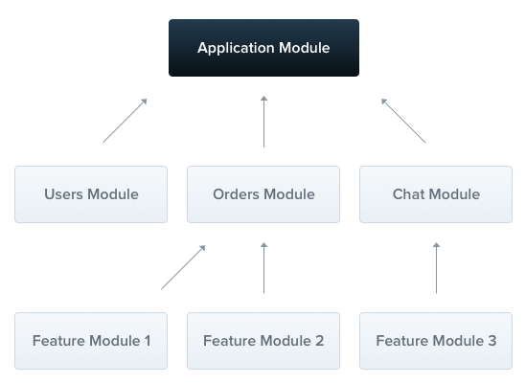
Modules

Slide 42
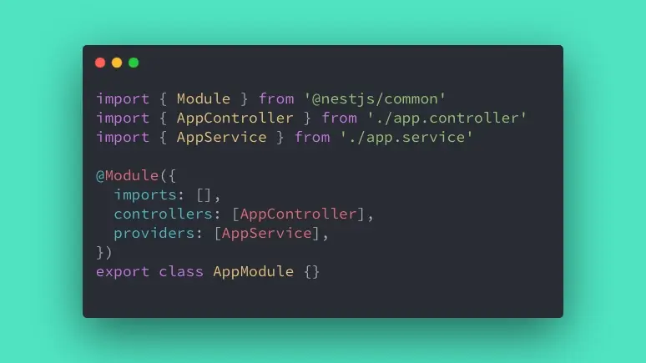

Slide 43
Understanding Modules in NestJS
Singleton Design Pattern
Each module in NestJS is a singleton.
This means it is instantiated once during the application lifecycle.
All providers registered in the module also follow the singleton pattern by default.
Exception: If a provider is explicitly configured with a different scope (e.g., Scope.REQUEST or Scope.TRANSIENT), NestJS will create a new instance of that provider for each request or injection, respectively.

Slide 44
Understanding Modules in NestJS
Encapsulation by Default
NestJS encapsulates providers inside the module by default.
This means providers are not visible or injectable outside the module unless they are explicitly exported.

Slide 45
Understanding Modules in NestJS
Shared Module Behavior
Every module is automatically “Shared“.
Once a module is imported into another module, it becomes "shared" in the context of that module.
This allows all exported providers from the shared module to be available in the importing module without redefining them.

Slide 46
Understanding Modules in NestJS
Why Use Imports Instead of Direct Registration?
If a provider (e.g., CatsService) is directly registered in multiple modules, each module will get its own instance, breaking the singleton behavior.
Instead, you should import the module that defines the provider once, and Nest will ensure only one instance is shared.

Slide 47
@Module({providers: … , controllers: … , …}) Properties
providers:
Classes/services that Nest can inject (e.g., services, repositories).
controllers:
Controllers that handle incoming HTTP requests.
imports:
Other modules whose exported services/providers are required here.
exports:
Providers made available to other modules that import this one.

Slide 48
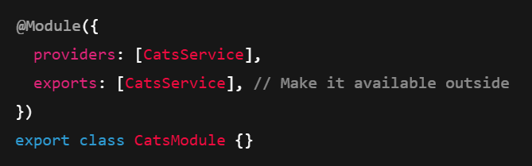
How to Share a Provider
To share a provider like CatsService:
Define and register CatsService in its own module (e.g., CatsModule).
Add CatsService to the exports array of CatsModule.
Import CatsModule in any other module that needs to use CatsService.

